Slide 1



Inventory Management System
A Project Report for Minor Project
Submitted By
Devanjana Ghosh (30901220147)
Ananya Chatterjee (30901220149)
Ayan Pradhan (30901220150)
Deepsikha Santra (30901220166)
In partial fulfilment for the award of the degree
Of
Bachelor of Computer Application
College Code: 309; Subject Code: BCAD581
Guide Name: Anindya Mukherjee
Session:2020-2023

Slide 2
INDEX
Introduction
Software Requirements Specification (SRS)
System Design
Testing
Screen Design
Limitations
Future Scope and Further Enhancement
Conclusion
Bibliography/Webliography

Slide 3
INTRODUCTION
What is Inventory Management System for a Departmental store?
Inventory management systems control the process of managing all incoming and outgoing products in a departmental store. Inventory management system reduce time on stock management tasks. Inventory management plays an important role to manage products, customer & supplier details for a departmental store.
IManager:
IManager Departmental store software to manage and sell your daily essential Medicine, Food, Fashion & Garment, Footwears, Electronics. IManager is a many problem one solution software. By using this software we can manage products, suppliers and customers details in an efficient and reliable manner.

Slide 4
Scope:
Easy to add and maintain records of available products.
Easily add and maintain customer and supplier details.
Generate and print invoice and bills in an efficient manner.
Provides a convenient solution of billing pattern.
Technology used:
Swing,
AWT,
JAVA( JAVA SE 18),
JDBC(Mysql-connector-java-8.0.31.jar),
MySQL

Slide 5
Software Requirements Specification (SRS)
Hardware:
RAM: 2 GB or above
Hard Disk : 10 GB
Monitor: 14’’ VGA.
Mouse and Keyboard
Printer: To print Bill
Software:
Operating System: Windows 8.1 or above
Back end: MySQL , Java SE 18

Slide 6
System Design
COCOMO(Constructive Cost Estimation Model) Model:
COCOMO Model predicts the efforts and schedule of a software product based on the size of the software( number of Lines of Code or LOC). This is one of the most generally used software estimation models in the world.
Software project type to which COCOMO is applied
Semi-detached
(>=50 KLOC)
Embedded
(>300KLOC)
Organic
(<50 KLOC)

Slide 7
Type of Software | a | b | c | d
Organic | 2.4 | 1.05 | 2.5 | 0.38
Semi-detached | 3.0 | 1.12 | 2.5 | 0.35
Embedded | 3.6 | 1.20 | 2.5 | 0.32
Basic COCOMO:
Total lines of code = 2600 LOC
= 2600/1000 KLOC
= 2.6 KLOC
Hence, the software falls into the Organic type.
Effort(EI) = a x (size of software in KLOC)^{b} PM
= 2.4 x (2.6)^{1.05} PM
= 6.5 PM
Development Time(T_{dev}) = c x (EI)^{d} Months
= 2.5 x (6.5)^{0.38} Months
= 5.1 Months

Slide 8
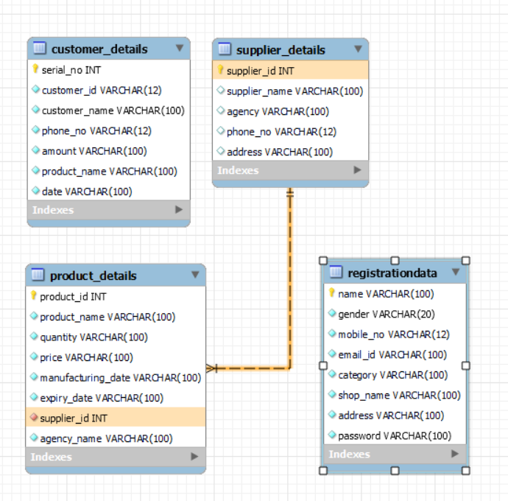
ERD (Entity Relationship Diagram):
The collection of tables of data is called a database . Entity relationship model is used here to obtain in a conceptual model of data used in this project.

Slide 9
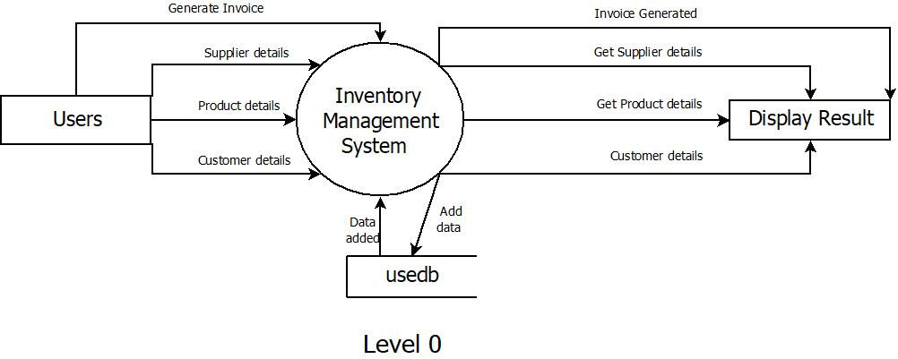
DFD (Data Flow Diagram):
DFD is a graphical representation of the data. It identifies the path the data will take, what process will take place to it from one to another.
Level 0 DFD:

Slide 10
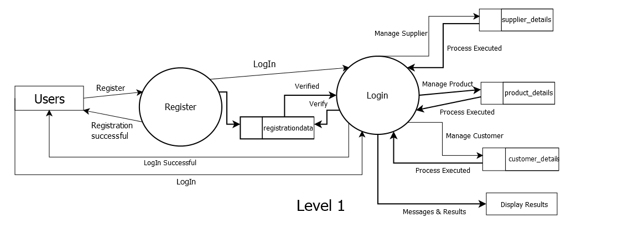
Level 1 DFD:

Slide 11
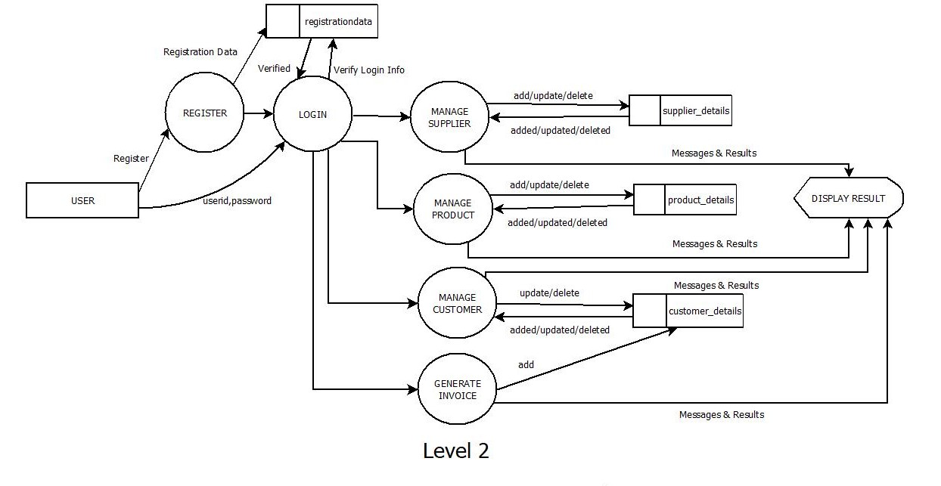
Level 2 DFD:

Slide 12
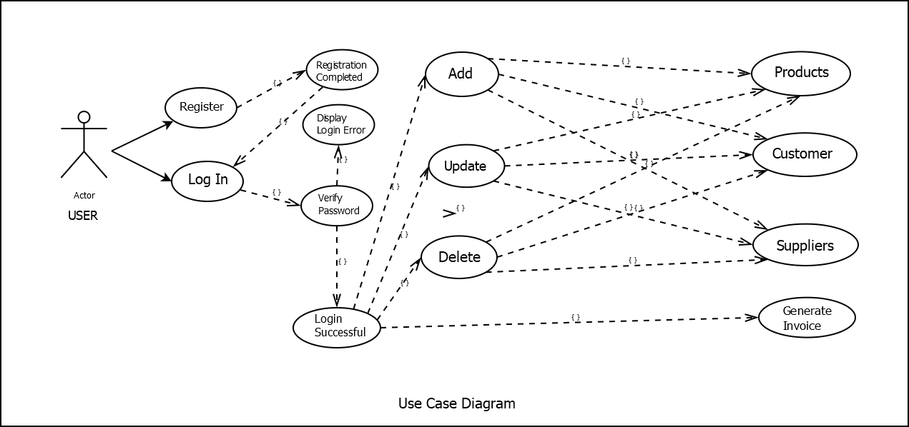
Use Case Diagram:
A use case diagram is used to represent the dynamic behaviour of a system. It encapsulates the system's functionality by incorporating use cases, actors, and their relationships.

Slide 13
Testing
Tests are frequently grouped by where they are added in the software development process, or by the level of specificity of the test.
Unit testing:
Unit testing refers to tests that verify the functionality of a specific section of code, usually at the function level. In an object-oriented environment, this is usually at the class level, and the minimal unit tests include the constructors and destructors.

Slide 14
Tested By: | Ayan Pradhan
Test Type: | Unit Testing
Modules /Functionalities to be tested | Input | Output | Test Condition | Result
Registration | Registration details such as name, gender, mobile no., email Id, category, shop name and password | Registration Successful message | An error message should be displayed if the any of the fields are incorrect empty/invalid mobile no. or name/password and confirm password not same: Enter all the details/Enter wrong data/Password not matched | Passed
Login | Login details: User id and password | Login Successful message and log into the dashboard | An error message should be displayed if the any of the fields are incorrect or empty: Invalid username or password | Passed
Add Supplier details | Supplier info | Added Successfully message and shows in the table | An error message should be displayed if any of the fields are empty/contain invalid name or Phone no.: Enter all details/ Invalid name or mobile no. | Passed
Add/Update Product Details | Product info | Added/Updated Successfully message and shows in the table | An error message should be displayed if any of the fields are empty/price and quantity are characters: Enter all details/Price and quantity cannot be characters | Passed

Slide 15
Update Supplier/ Customer Details | Supplier/ Customer info | Updated Successfully message and shows in the table | An error message should be displayed if any of the fields are empty/contain invalid name or phone no.: Enter all details/Invalid name or mobile no. | Passed
Delete Supplier/Product/ Customer Details | Supplier/Product /Customer info | Deleted Successfully message and deleted from the table |  | Passed
Generate Invoice | Product details, quantity,tax, customer phone no and name | Invoice Generated message and print option | An error message should be displayed if any of the fields are empty: Enter all details | Passed
Printing Invoice | Click on the Print button | Invoice Printed message and a pdf file will be created |  | Passed
Logout | Click on the Logout button in dashboard | Return to the Welcome page |  | Passed

Slide 16
Screen Design
Imanager: LOGO of the Software

Slide 17
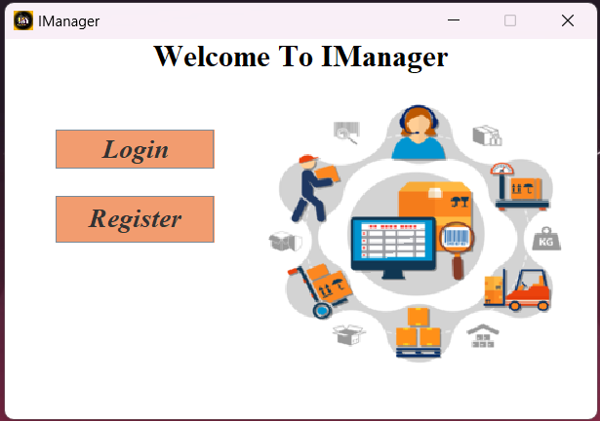
Welcome Page

Slide 18
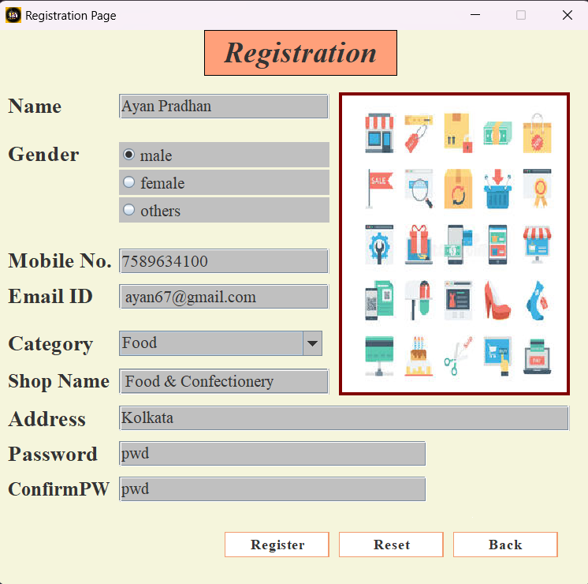
Registration Page

Slide 19
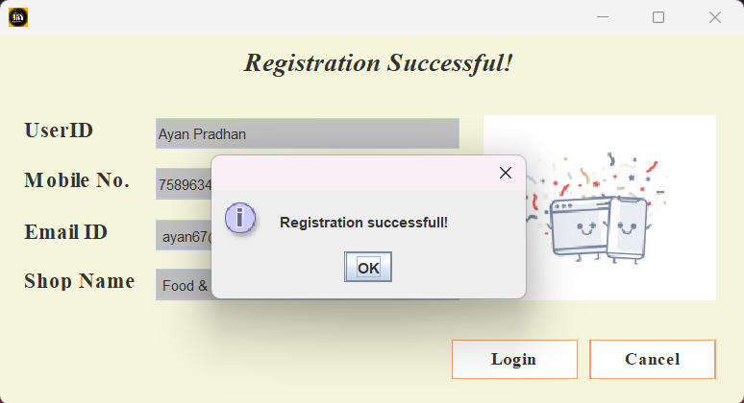
Registration Done Successfully

Slide 20
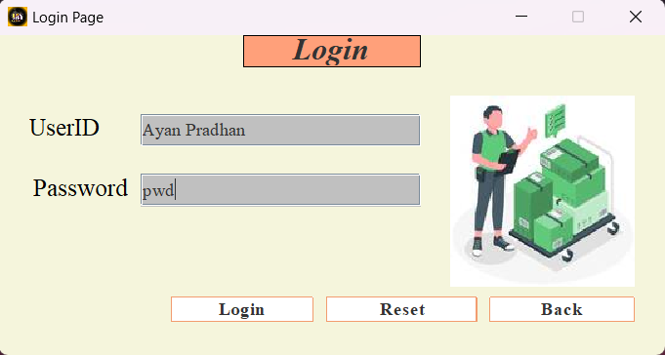
Login Page

Slide 21
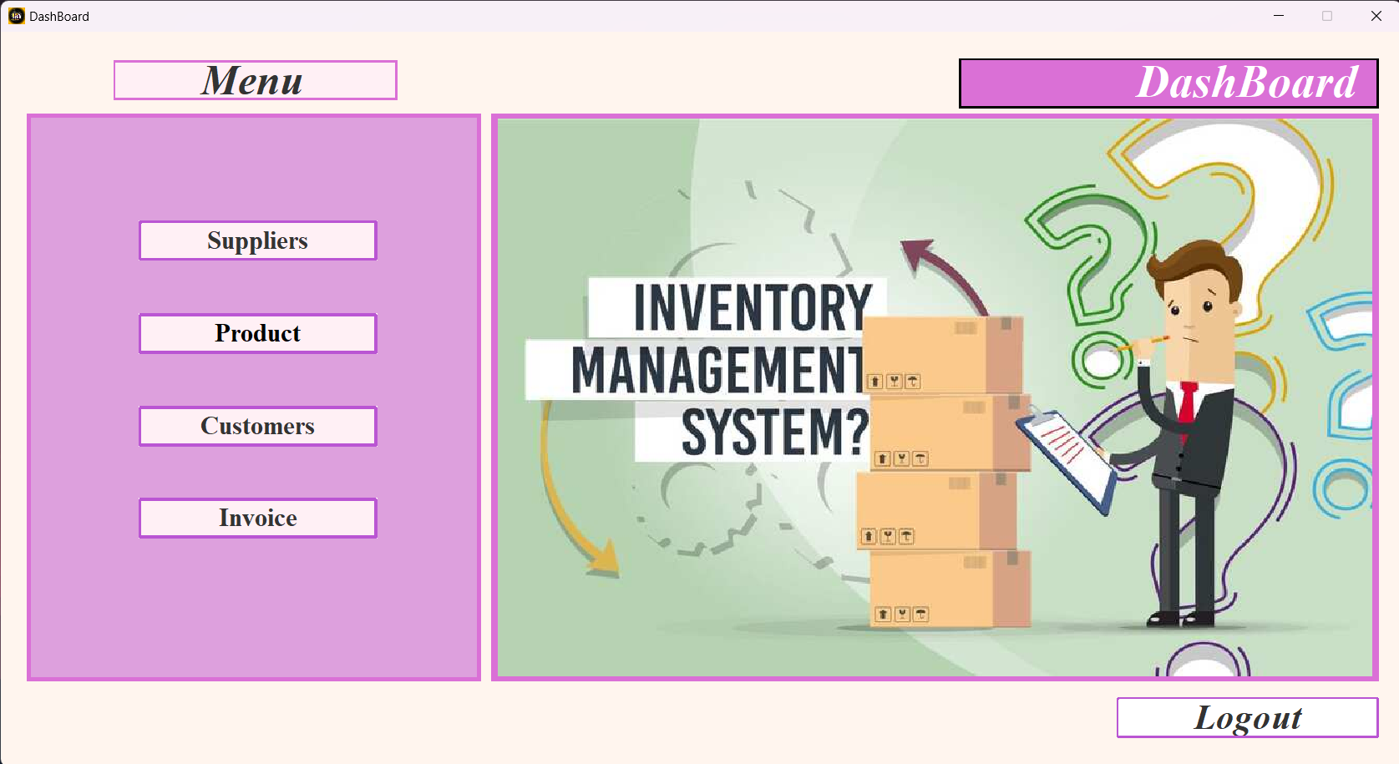
Dashboard

Slide 22
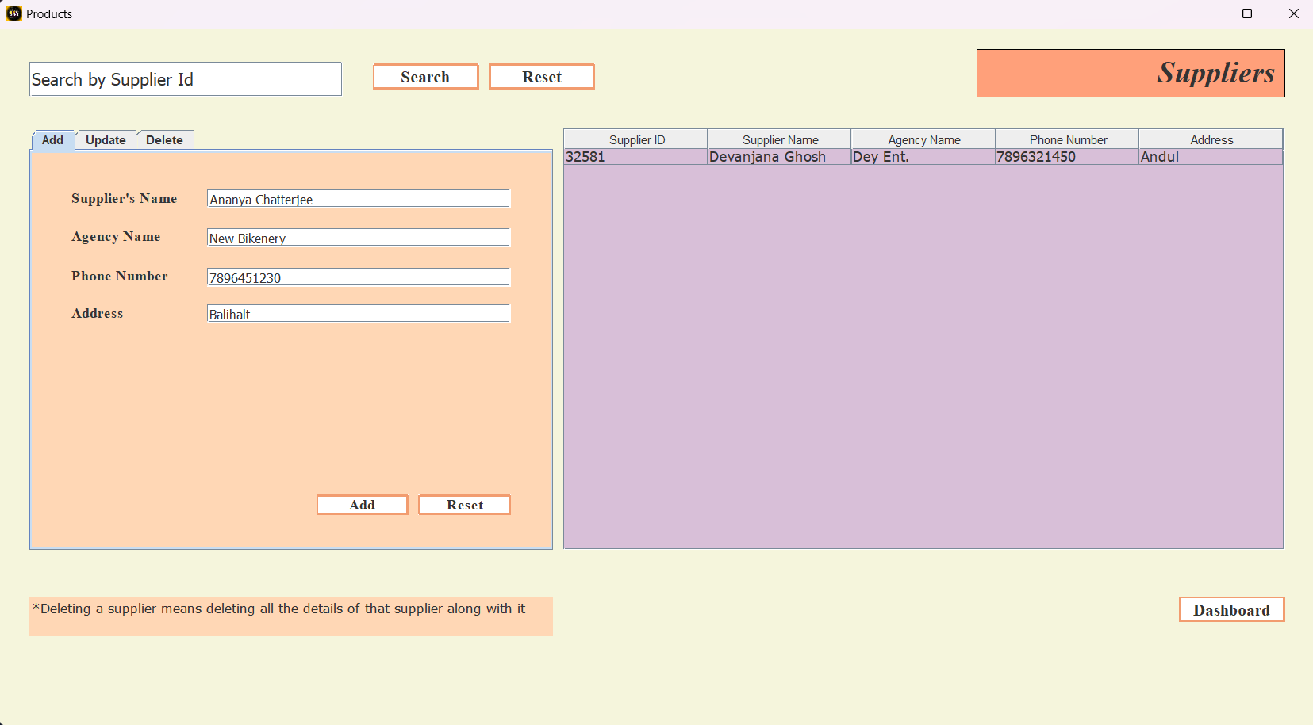
Supplier Table

Slide 23
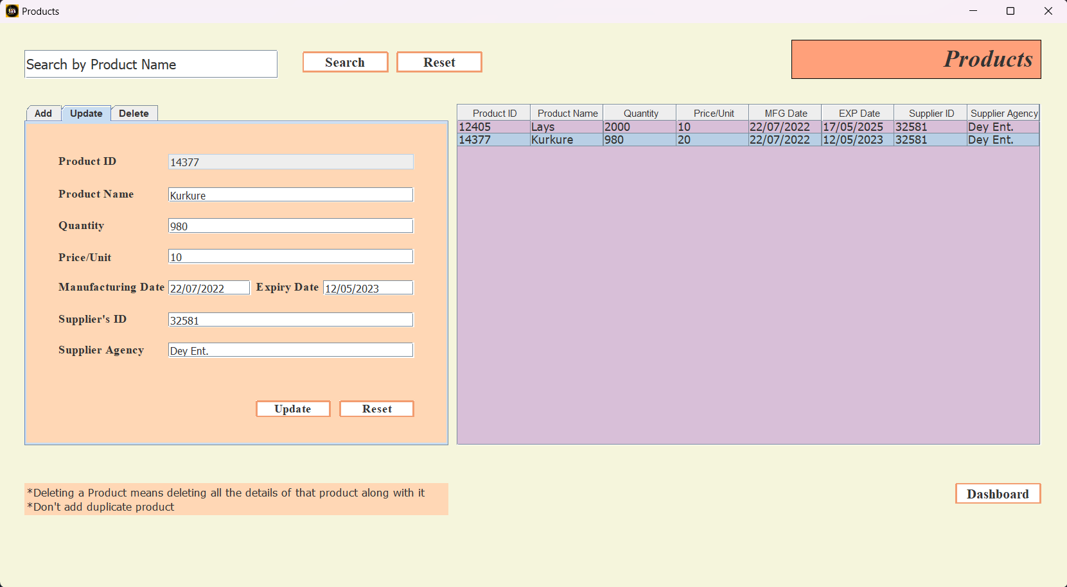
Product Table

Slide 24
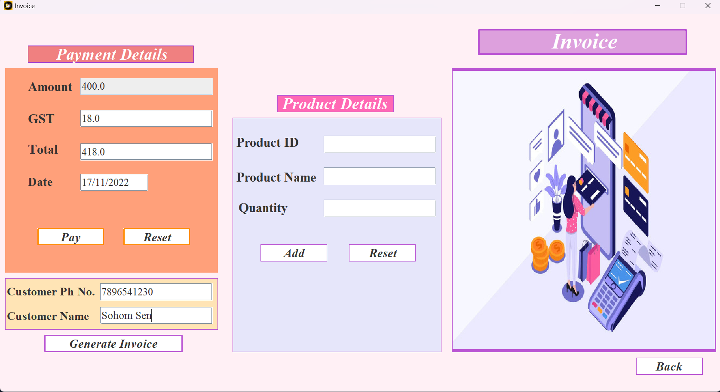
Invoice

Slide 25
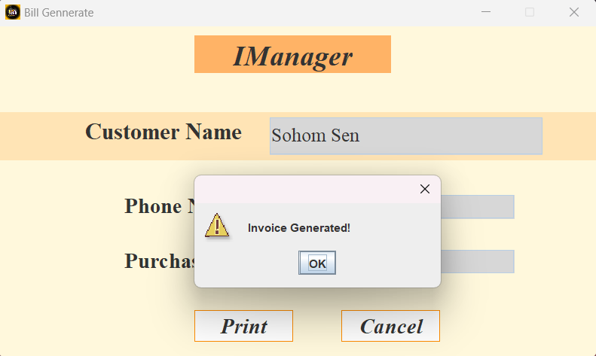
Invoice Generated

Slide 26
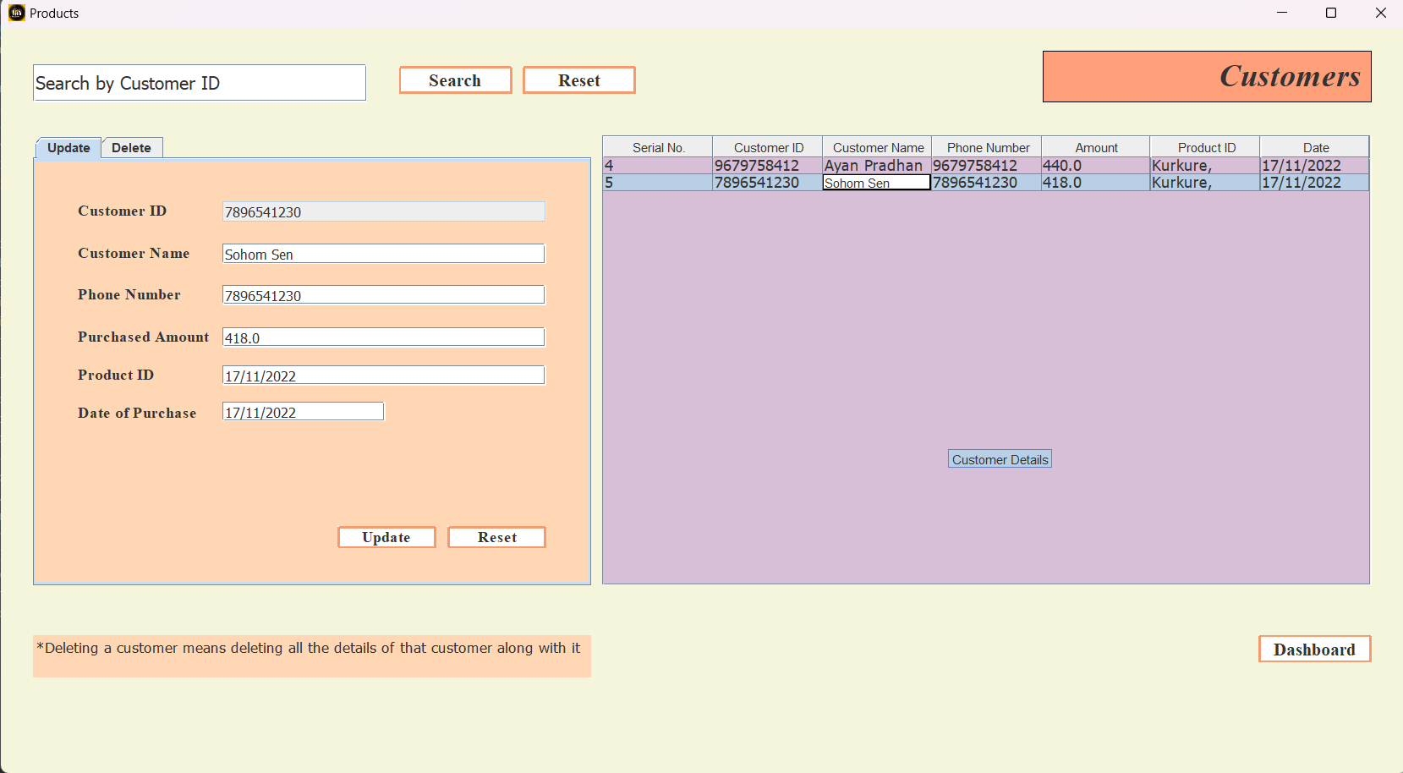
Customer Table

Slide 27
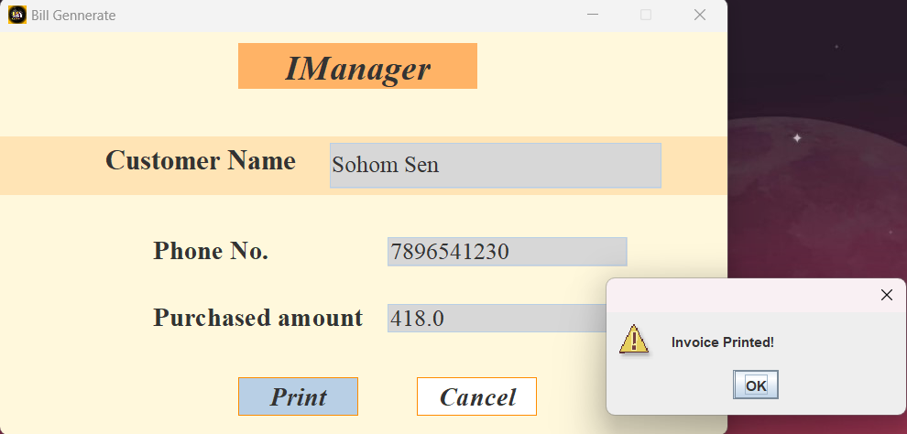
Print the Bill

Slide 28
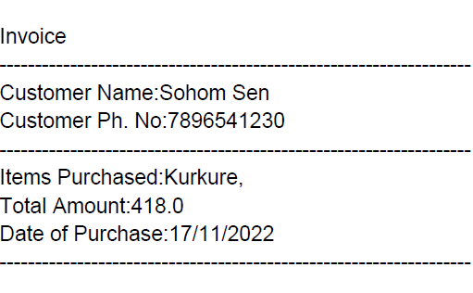
Bill printed

Slide 29
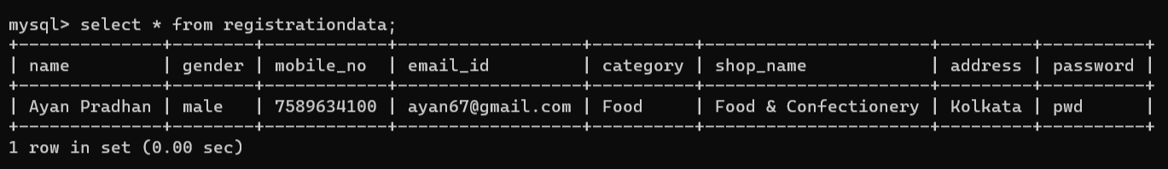
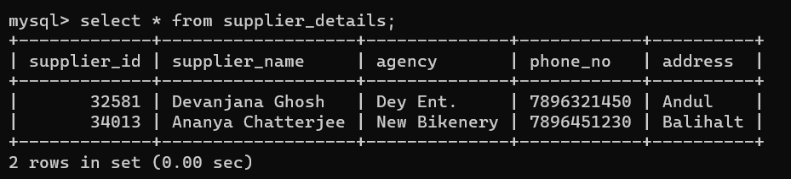
Database

Slide 30
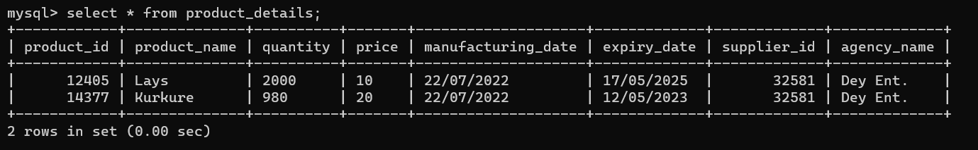
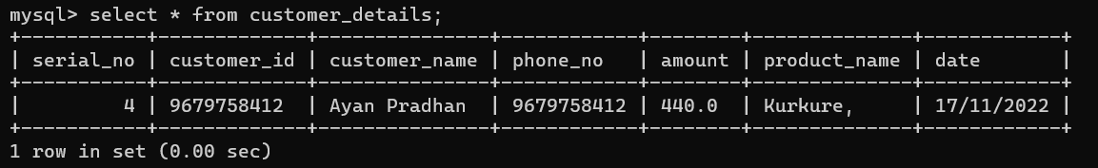

Slide 31
Limitations
Single User System: The major limitation of this system is that it’s a single user standalone application. That means there can’t be more than one user.
User Authentication: If the user forgot his/her login credentials then he/she will not be able to access the application; hence all of the data will be lost. Since there is no option for resetting the password, the user will need to uninstall the application and start over from the registration process.
Limited Functionalities: Functionalities are limited in this application.
Complex UI Poor UX: User interface is complex for new users; therefore user experience is hampered.

Slide 32
Future Scope and Further Enhancement
This software is a local database-based system. That means all the data of the user will be stored on a single client machine. If the user(manufacturer/retailer/other) has multiple shop on various locations/globally then this application will not help him/her for managing the inventory. So, a centralized /cloud database can be used in this software. That will make this application more practical and desired.
A web version of this software will be more efficient.
GST calculator, data back-up, quotation placing and various other functionalities can be embedded into the system.
This application can be made collaborating with ERP systems. That will enable manufacturers and retailers to attain full visibility into their global inventory.

Slide 33
Conclusion
Inventory management is a very complex but essential part of the supply chain. An effective inventory management system helps to reduce stock-related costs such as carrying and ordering costs. Inventory management helps companies identify which and how much stock to order at what tie. It tracks inventory from purchase to the sale of goods. The practice identifies and responds to trends to ensure there’s always enough stock to fulfill orders and proper warning of a shortage.

Slide 34
Bibliography/Webliography
https://www.java.com/en/
https://www.eclipse.org/
https://www.mysql.com/
https://www.w3schools.com/
https://docs.oracle.com/en/java/
https://www.geeksforgeeks.org/
https://www.slideshare.net/
https://www.javatpoint.com/
https://www.codewithharry.com/
https://youtube.com/c/BroCodez
https://youtube.com/@CSCORNERSunitaRai
https://youtube.com/@Amit.Thinks
https://www.wikipedia.org/

Slide 35
Thank You
☺

